Slide 1
Microsoft Build 2023

Slide 2
All things client and mobile application development with .NET
Matthew Leibowitz | Software Guy at MS | @mattleibow

Slide 3
.NET Multi-platform App UI (MAUI)
Generally available
Unified .NET
Single project system, single codebase
Mobile, desktop, hybrid
WinUI
Mac
Catalyst
iOS
Android
Productive development
Native APIs, Native performance
40+ UI controls
Common platform services
Accessible by default
macOS
iOS
Visit dot.net/maui for more

Slide 4

.NET offers choice for developers
BLAZOR
C#, HTML, CSS
BLAZOR + .NET MAUI
.NET MAUI
C#, XAML
Reach
Depth
Websites and PWAs
Hybrid
Native

Slide 5



























All up cust. Logo slide 2

Slide 6
.NET MAUI is Growing and Active!
.NET MAUI is Growing!
Most active .NET Foundation project
Project | Pull Requests
.NET MAUI | 1779
Azure SDK | 1460
ASP.NET Core | 641
Windows Forms | 322
EF Core | 212
WPF | 199
MSBuild | 196
WCF | 86
Project | Issues
.NET MAUI | 1301
ASP.NET Core | 1057
Azure SDK | 677
EF Core | 468
Windows Forms | 181
MSBuild | 165
Orleans | 86
+636%

Slide 7
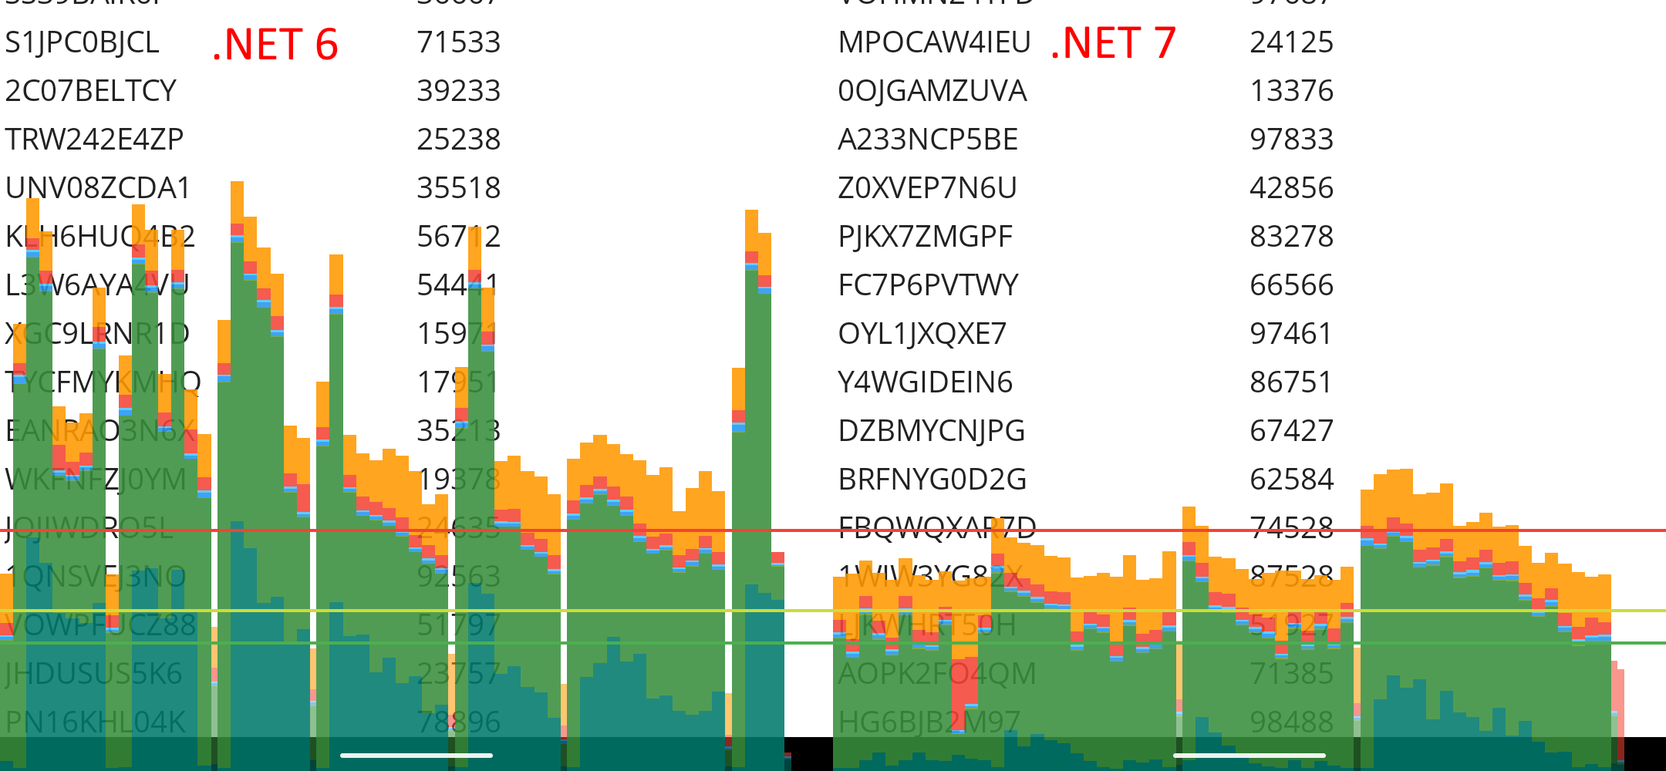
.NET 7 Performance
^51%
Faster UI Rendering
Smoother Scrolling
^
545ms
5%
Android Startup
Smaller iOS App Size
https://aka.ms/maui-7-perf

Slide 8
Visual Studio Improvements
^35%
1/3 less
Pair to Mac Success Rate
Hot Reload Errors
^14%
^12%
First Build Success
First Launch Success

Slide 9
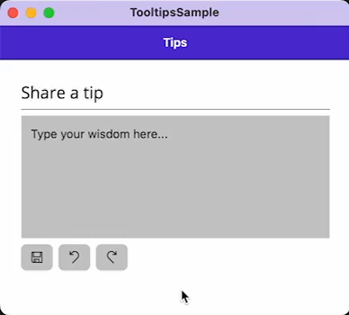
Tooltips
<HorizontalStackLayout Spacing="8">
<Button Text="{x:Static icons:FabIconFont.Save}"
ToolTipProperties.Text="Save"
FontFamily="FabricIcon"/>
<Button Text="{x:Static icons:FabIconFont.Undo}"
ToolTipProperties.Text="Undo"
FontFamily="FabricIcon"/>
<Button Text="{x:Static icons:FabIconFont.Redo}"
ToolTipProperties.Text="Redo"
FontFamily="FabricIcon"/>
</HorizontalStackLayout>

Slide 10
Pointer Hover
<Style TargetType="Button">
<Setter Property"FontSize" Value="18"/>
<Setter Property="VisualStateManager.VisualStateGroups">
<VisualStateGroupList>
<VisualStateGroup x:Name="CommonStates">
<VisualState x:Name="Normal">
<VisualState.Setters>
<Setter Property="Background" Value="{StaticResource Gray200}"/>
<Setter Property="TextColor" Value="{StaticResource Gray950}"/>
</VisualState.Setters>
</VisualState>
<VisualState x:Name="PointerOver">
<VisualState.Setters>
<Setter Property="TextColor" Value="{StaticResource White}" />
<Setter Property="Background" Value="{StaticResource Primary}" />
</VisualState.Setters>
</VisualState>
</VisualStateGroup>
</VisualStateGroupList>
</Setter>
</Style>

Slide 11
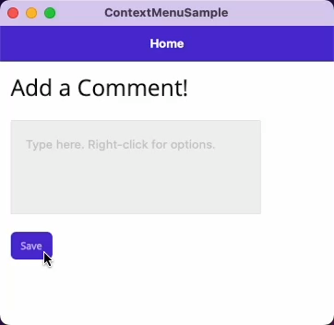
Context Menu
<Editor>
<FlyoutBase.ContextFlyout>
<MenuFlyout>
<MenuFlyoutItem Text="Increase font"
Clicked="OnIncrease"/>
<MenuFlyoutItem Text="Decrease font"
Clicked="OnDecrease"/>
<MenuFlyoutItem Text="Clear"
Clicked="OnClear"/>
</MenuFlyout>
</FlyoutBase.ContextFlyout>
</Editor>

Slide 12
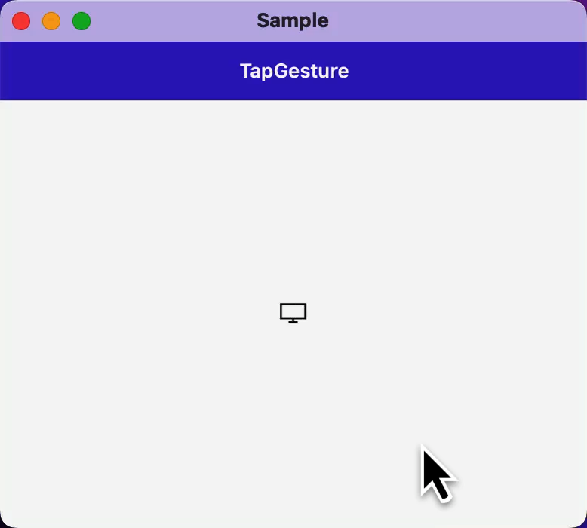
Right-Click
<Editor.GestureRecognizers>
<TapGestureRecognizer Buttons="Primary"
NumberOfTapsRequired="2"
Tapped="Primary_Tapped"/>
<TapGestureRecognizer Buttons="Secondary"
Tapped="Secondary_Tapped"/>
</Editor.GestureRecognizers>

Slide 13






Component Vendors

Slide 14
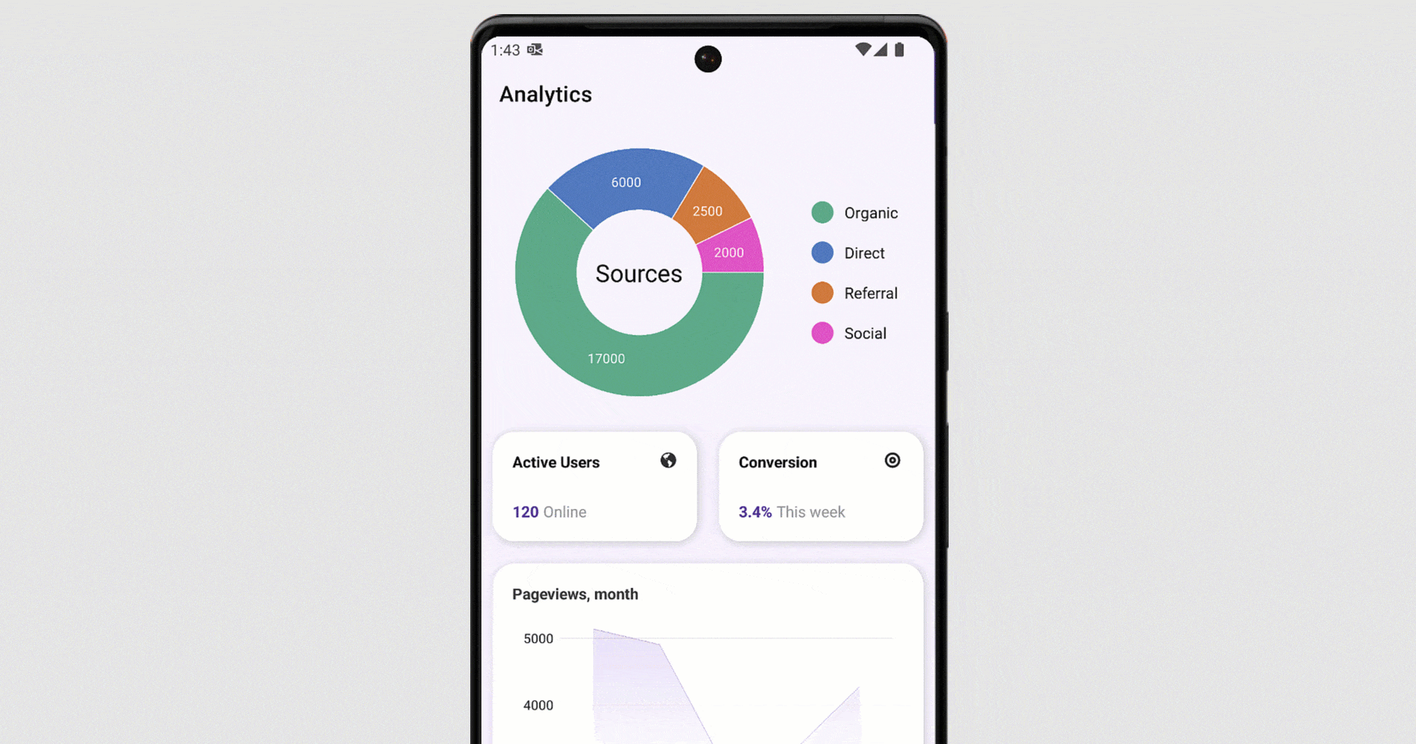

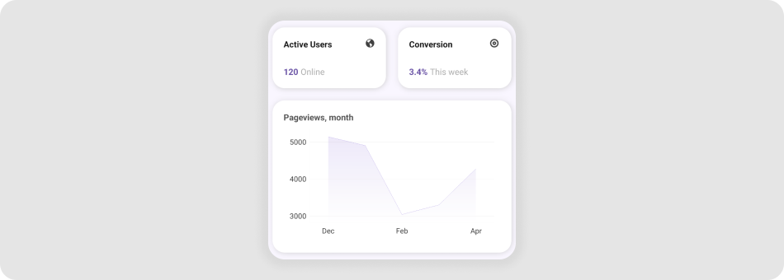
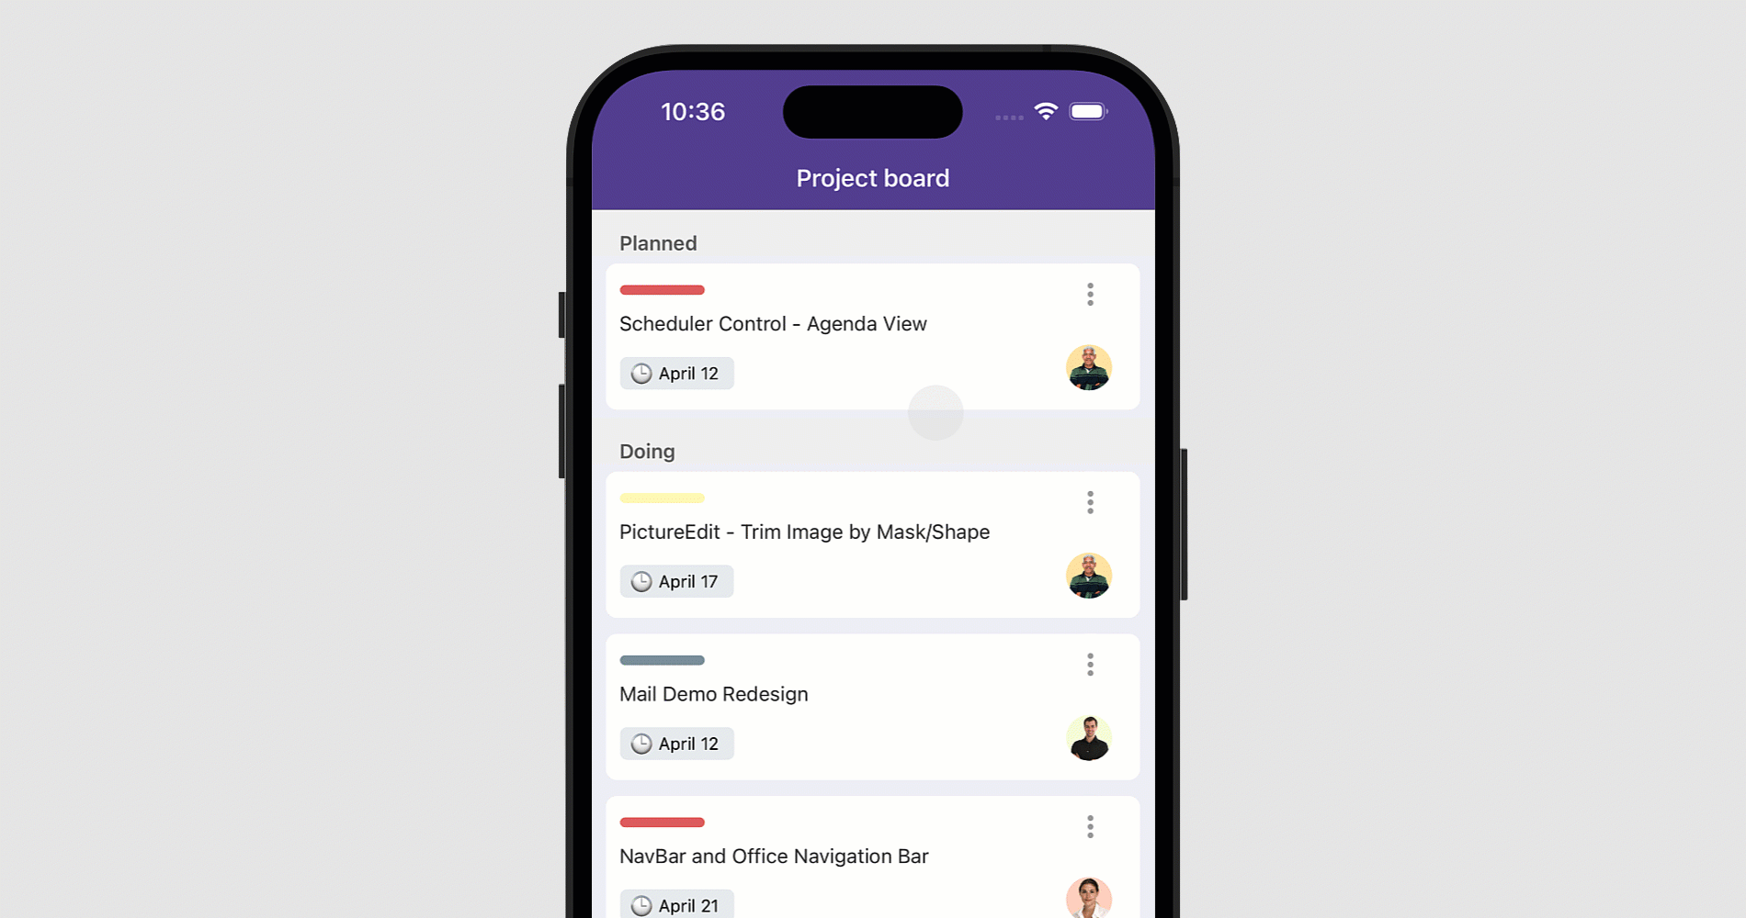
DevExpress
All controls are FREE
DataGrid, CollectionView, Filtering, CRUD
Integration with Office File library
Many samples and docs

Slide 15
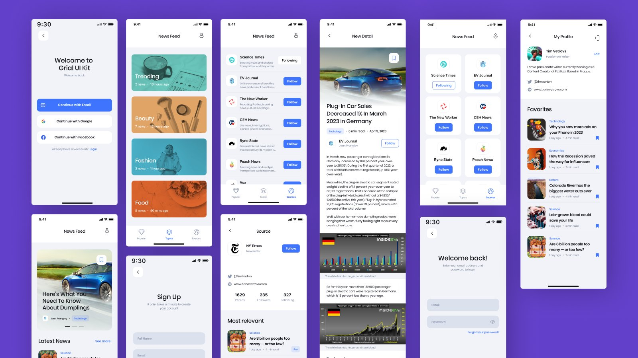

Grial

Slide 16
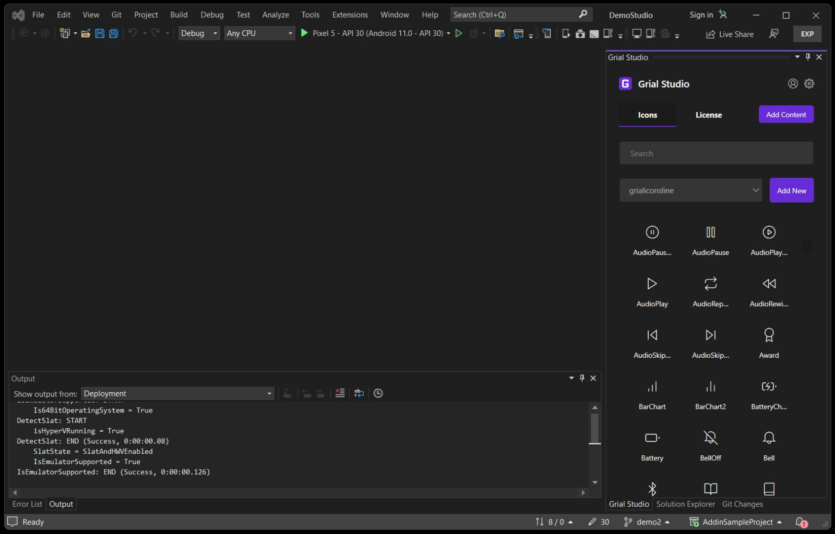
Screenshot
https://bit.ly/3qbZBjF

Slide 17
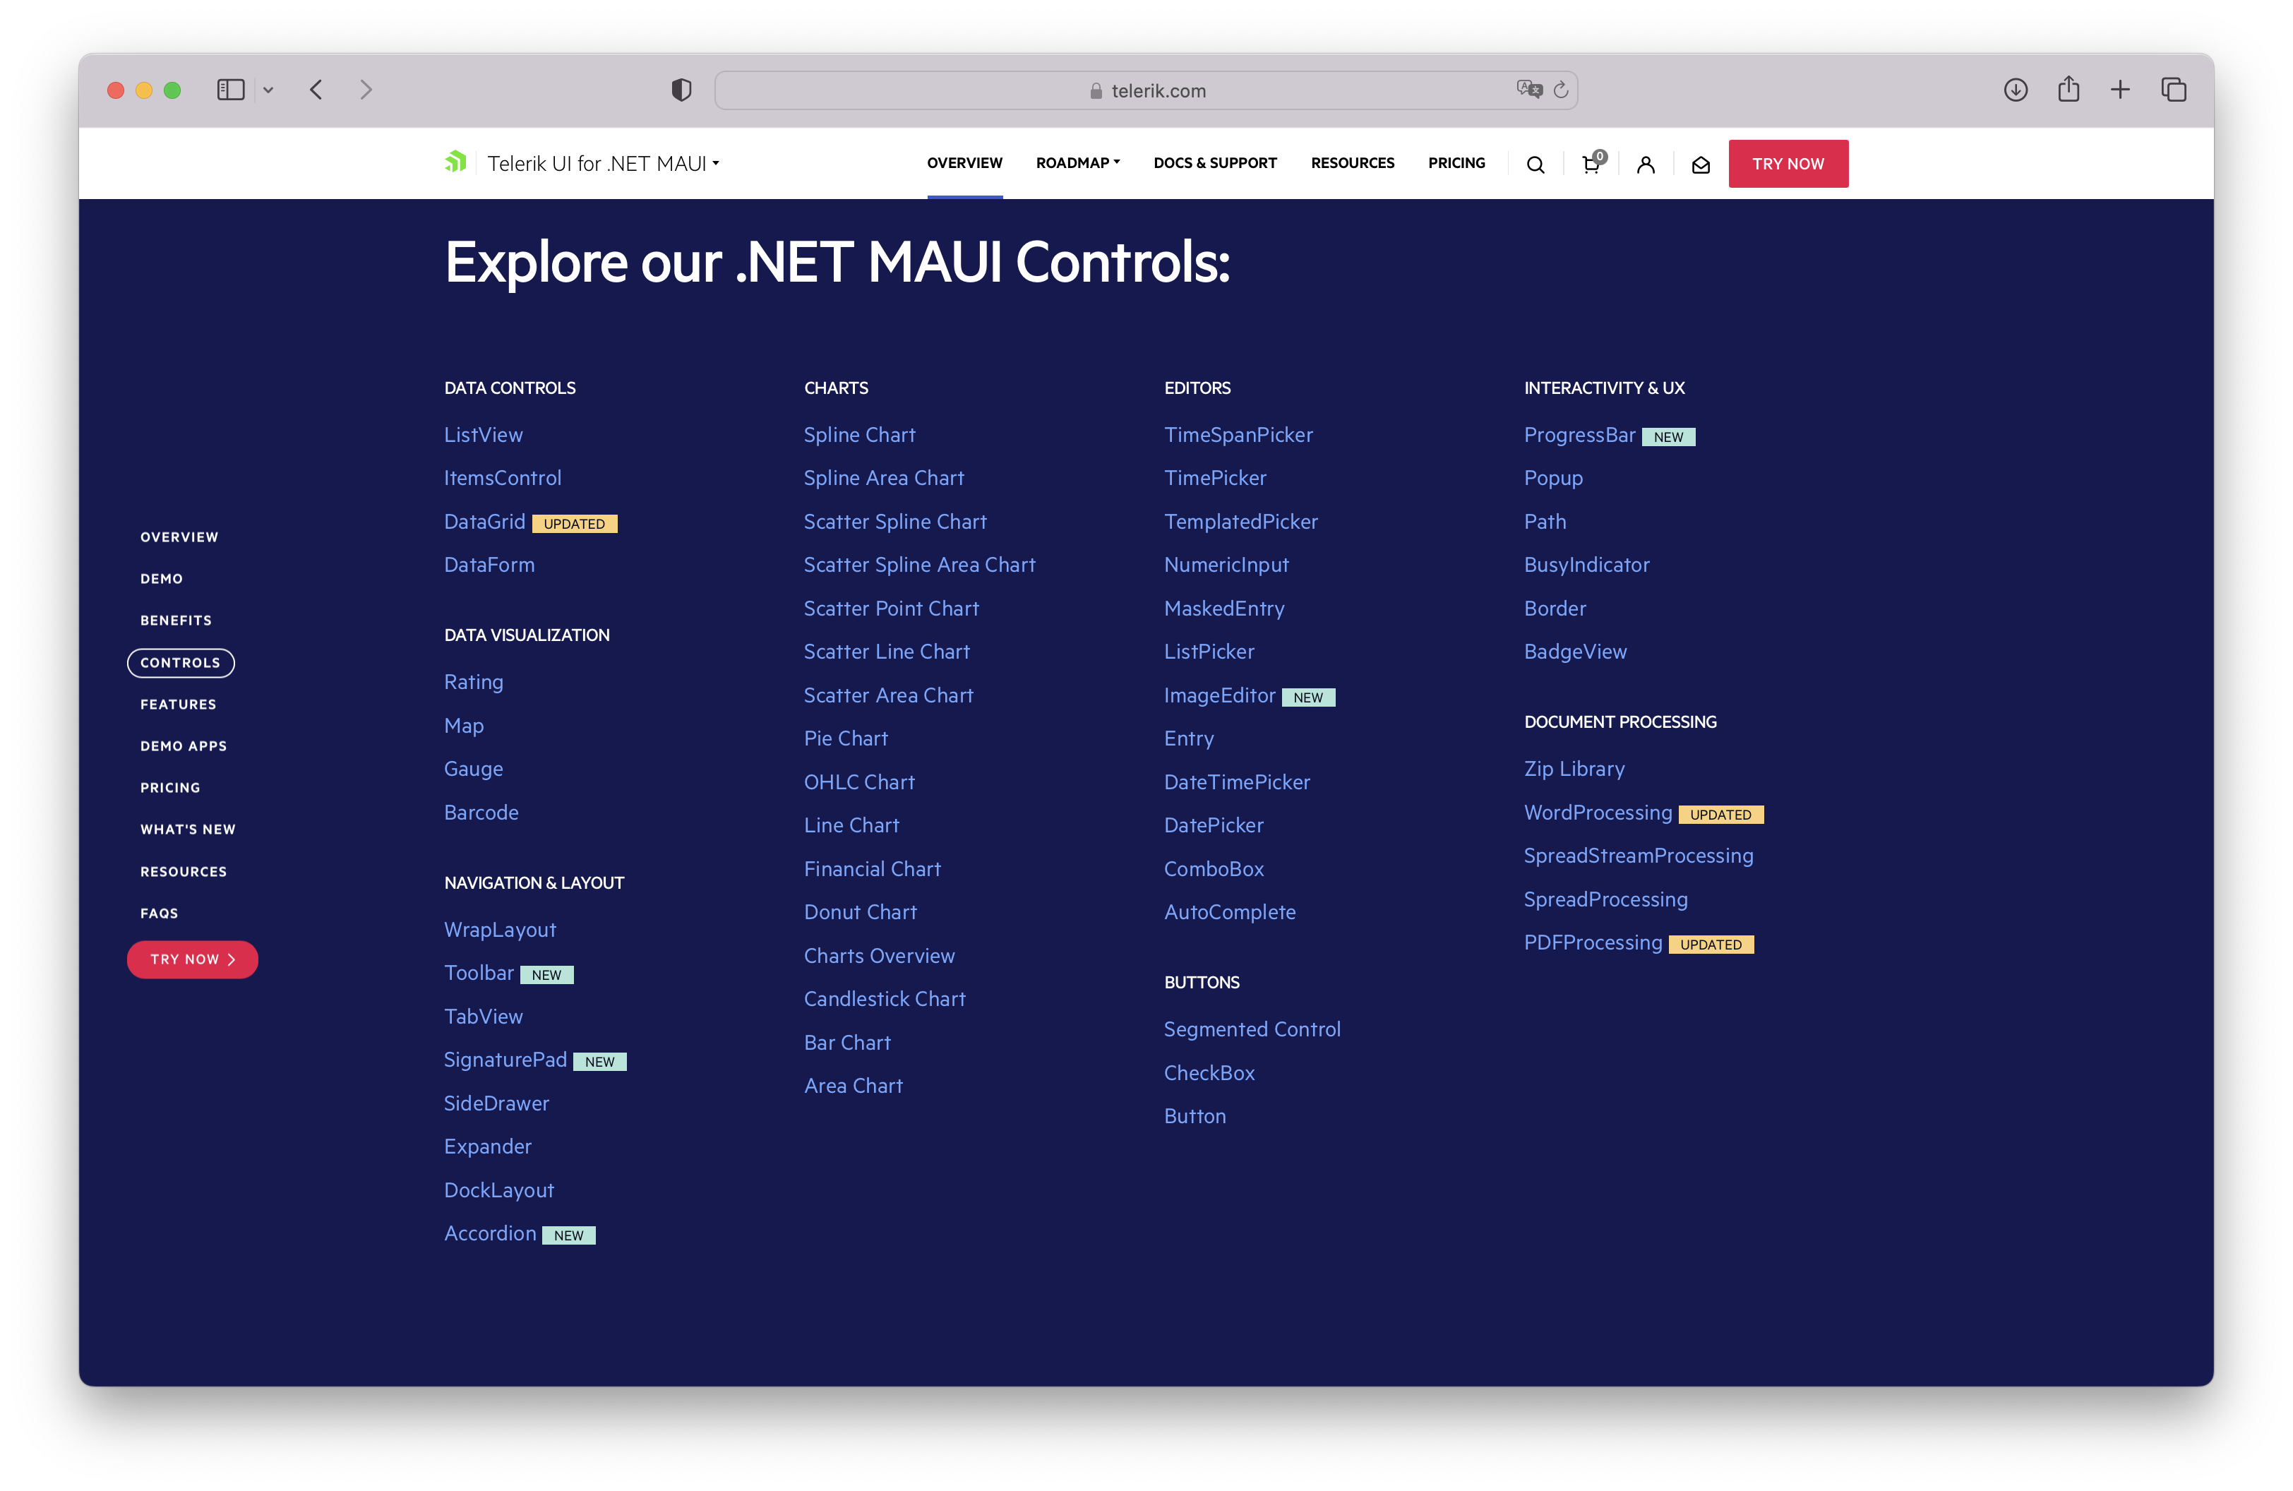
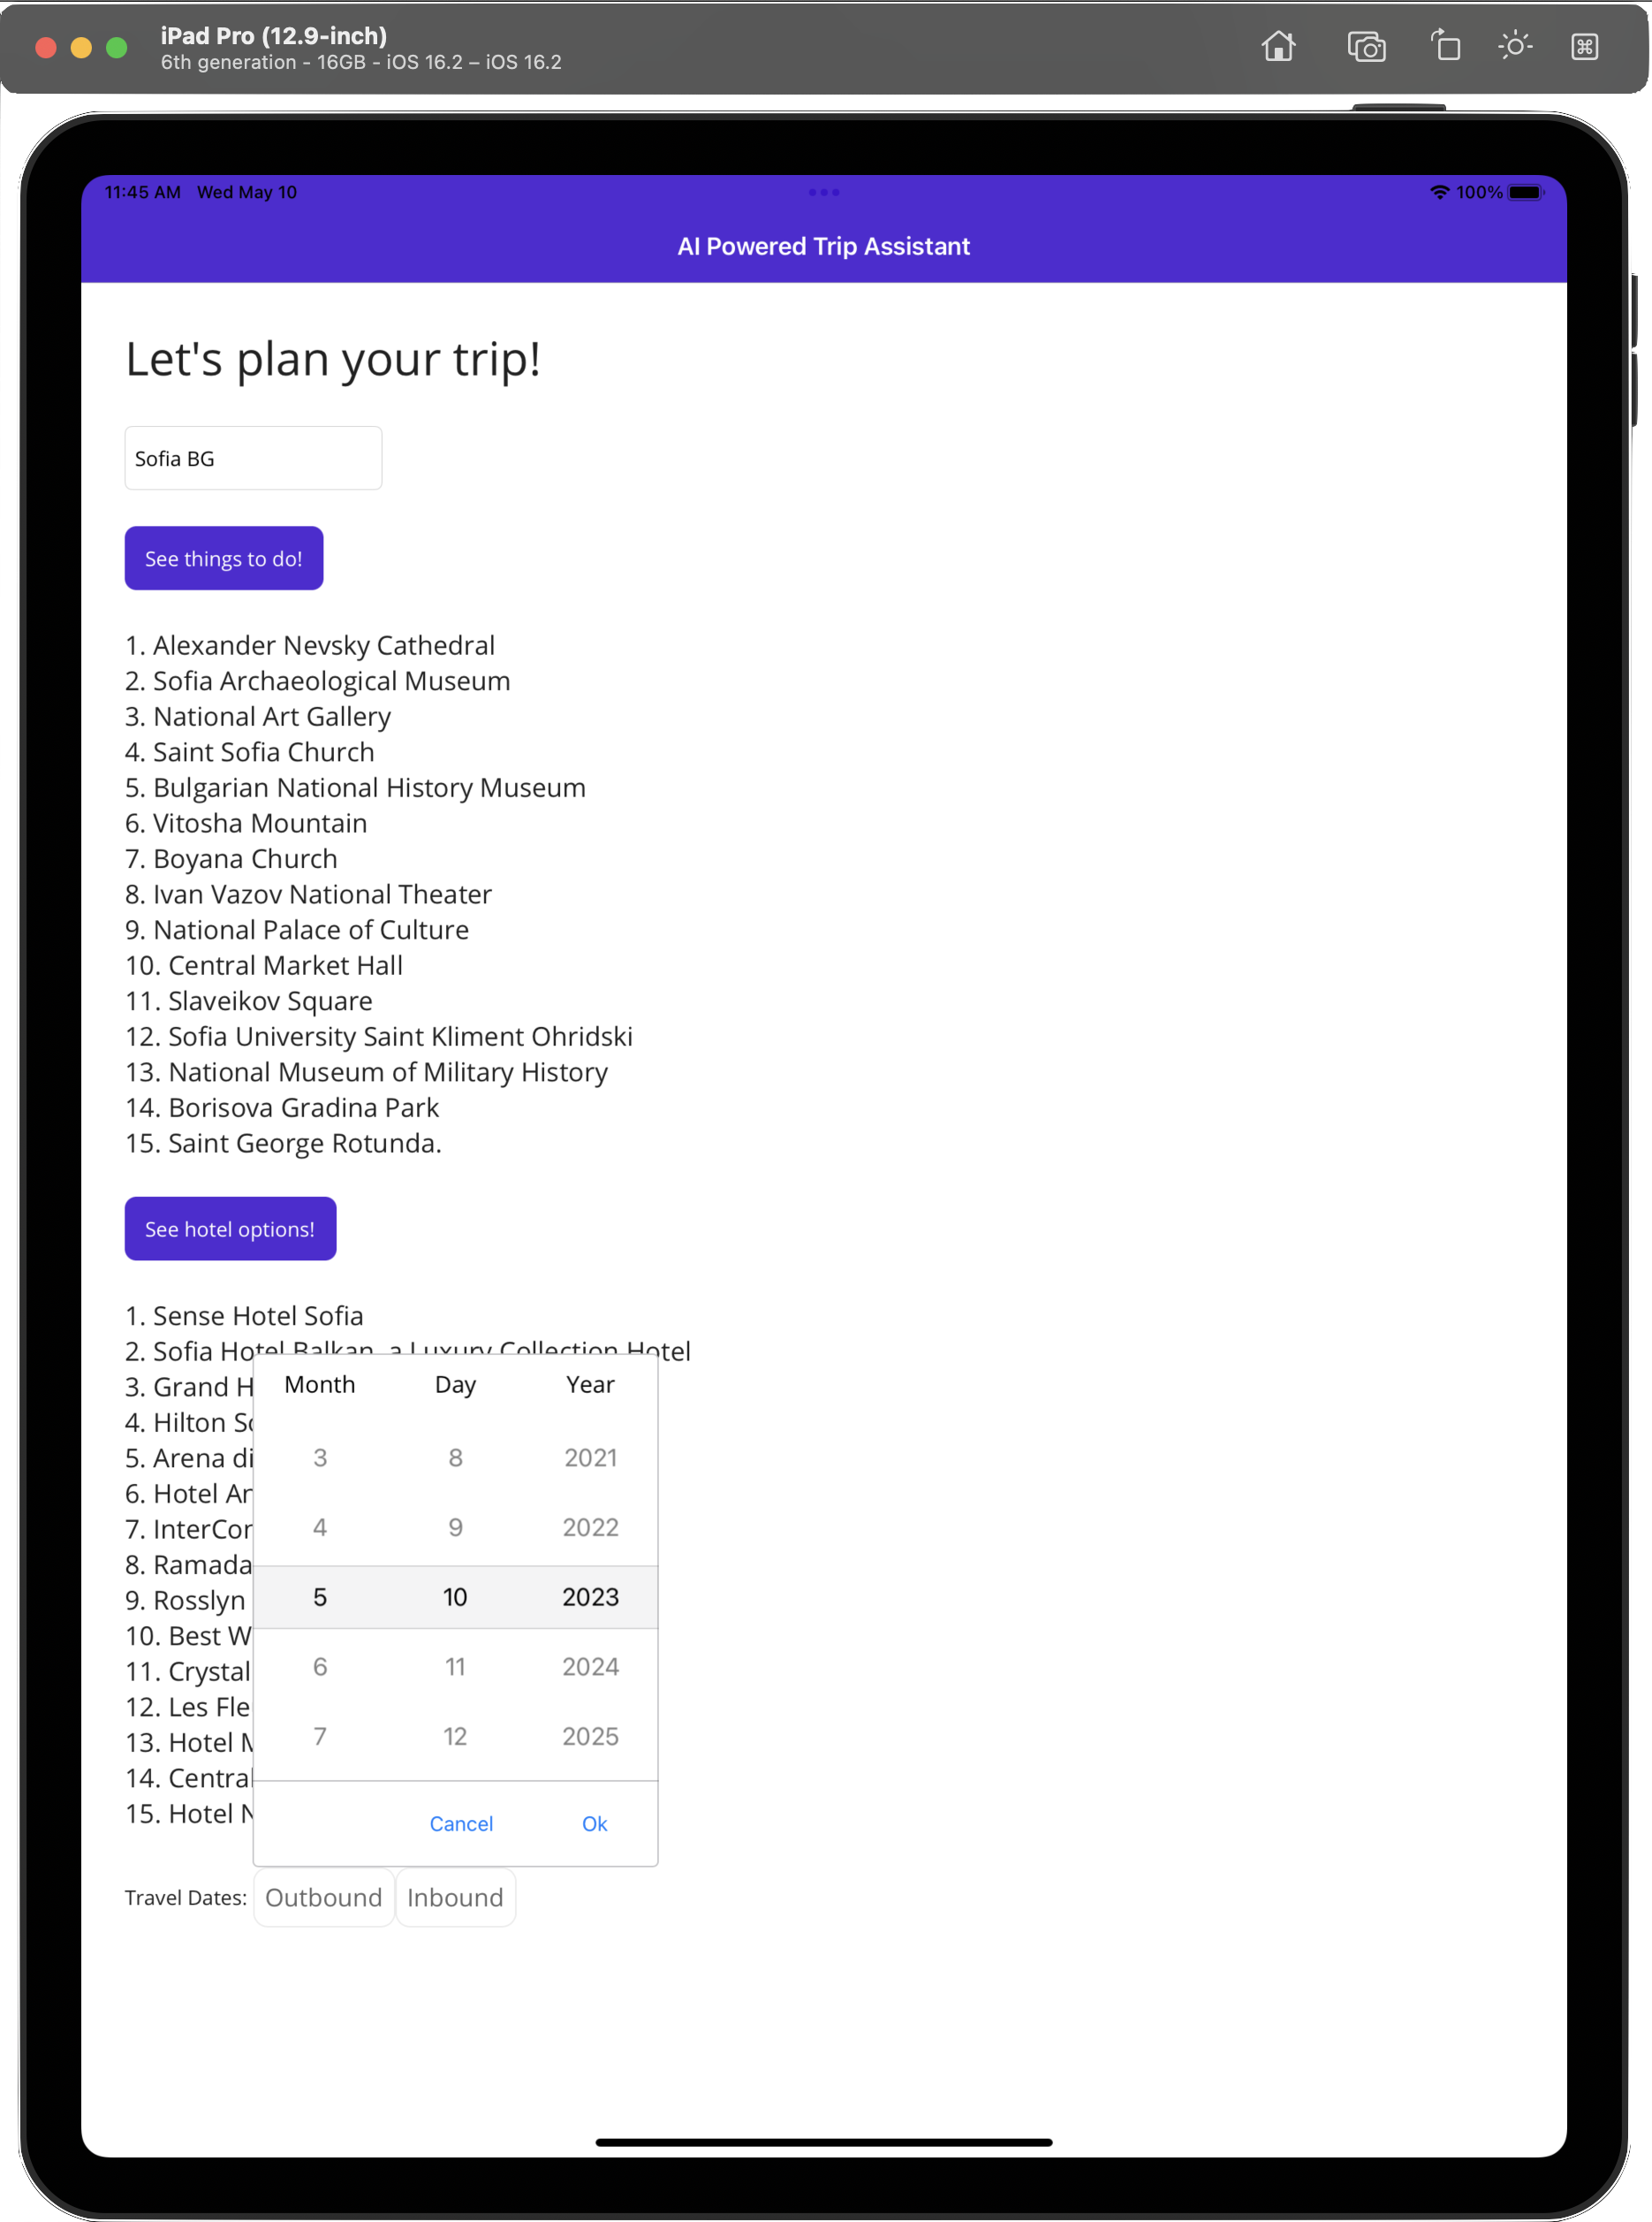
Telerik UI for .NET MAUI

Slide 18
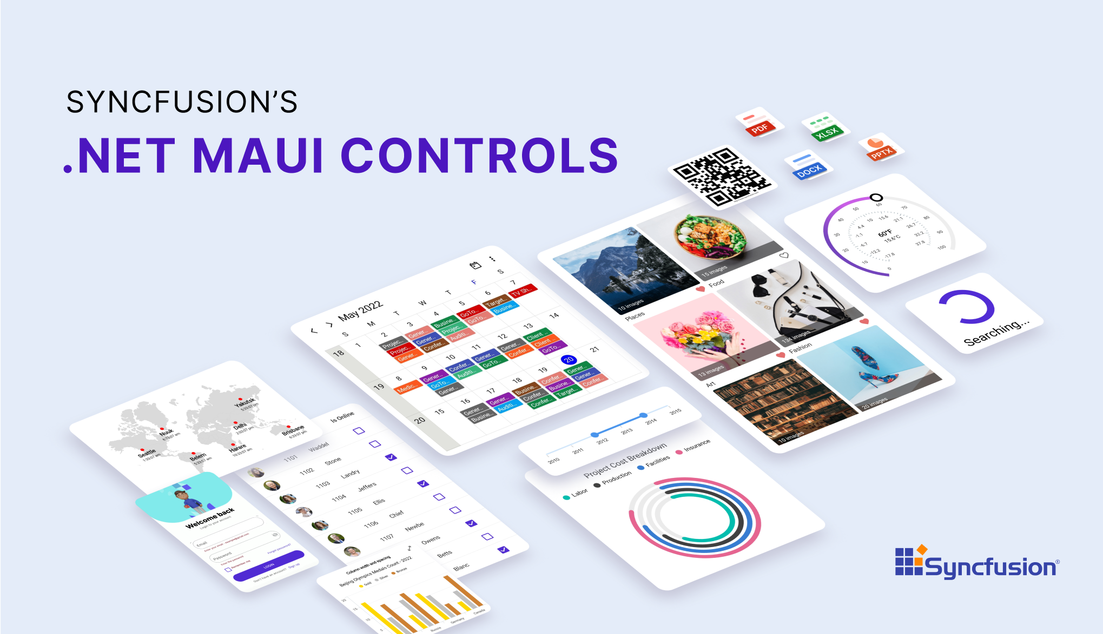
Syncfusion

Slide 19

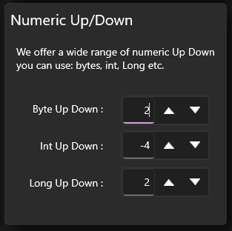
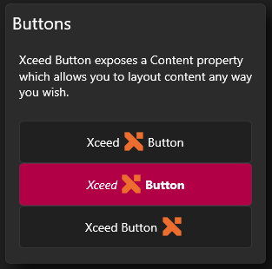
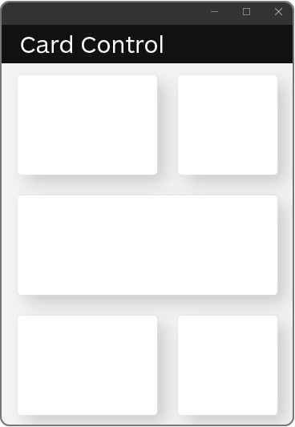
https://github.com/xceedsoftware/mauitoolkit
Free Controls:
Border
Button
ToggleButton
RepeatButton
NumericUpDown
ContentControl
ButtonSpinner
Card

Slide 20
Coming in .NET 8
Stability
Workloads
Desktop
Hybrid
Native
Quality effort report for top feedback
Memory mgmt and perf improvements
dotnet workload clean
NuGet packages for previews
Form navigation with keyboard
Keyboard listeners
Deep linking for Blazor Hybrid
HybridWebView
Smaller & faster apps with Native AOT
Sharing .NET libs to Obj-C and Swift

Slide 21
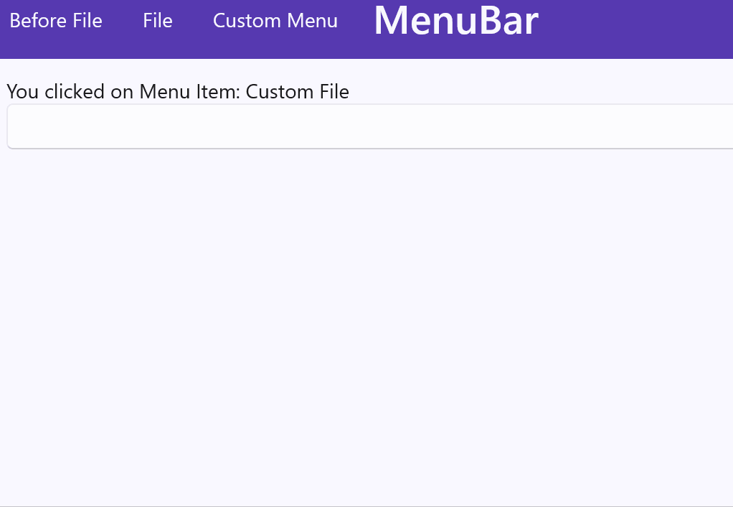
Accelerators
<MenuBarItem Text="File">
<MenuFlyoutItem Text="New"
Accelerator="ctrl+n"/>
<MenuFlyoutItem Text="Save"
Accelerator="ctrl+s"/>
<MenuFlyoutItem Text="Save as"
Accelerator="ctrl+shft+s"/>
<MenuFlyoutSeparator />
<MenuFlyoutItem Text="Exit"
Accelerator="ctrl+q"/>
</MenuBarItem>

Slide 22
Use Native Libraries with Platform Channels
public class LabelViewChannel extends ViewChannel {
@Override
public Object handleMessageFromDotNet(String messageId, Object... parameters) {
if (messageId.equals("setText")){
textView.setText((String)parameters[0]);
return textView.getText();
}
return null;
}
}
void Button_Clicked(System.Object sender, System.EventArgs e) {
var labelViewChannel = ChannelService.GetOrCreateChannel("labelViewChannel");
labelViewChannel.SendToPlatform("setText", "Hello, From MAUI!");
}

Slide 23
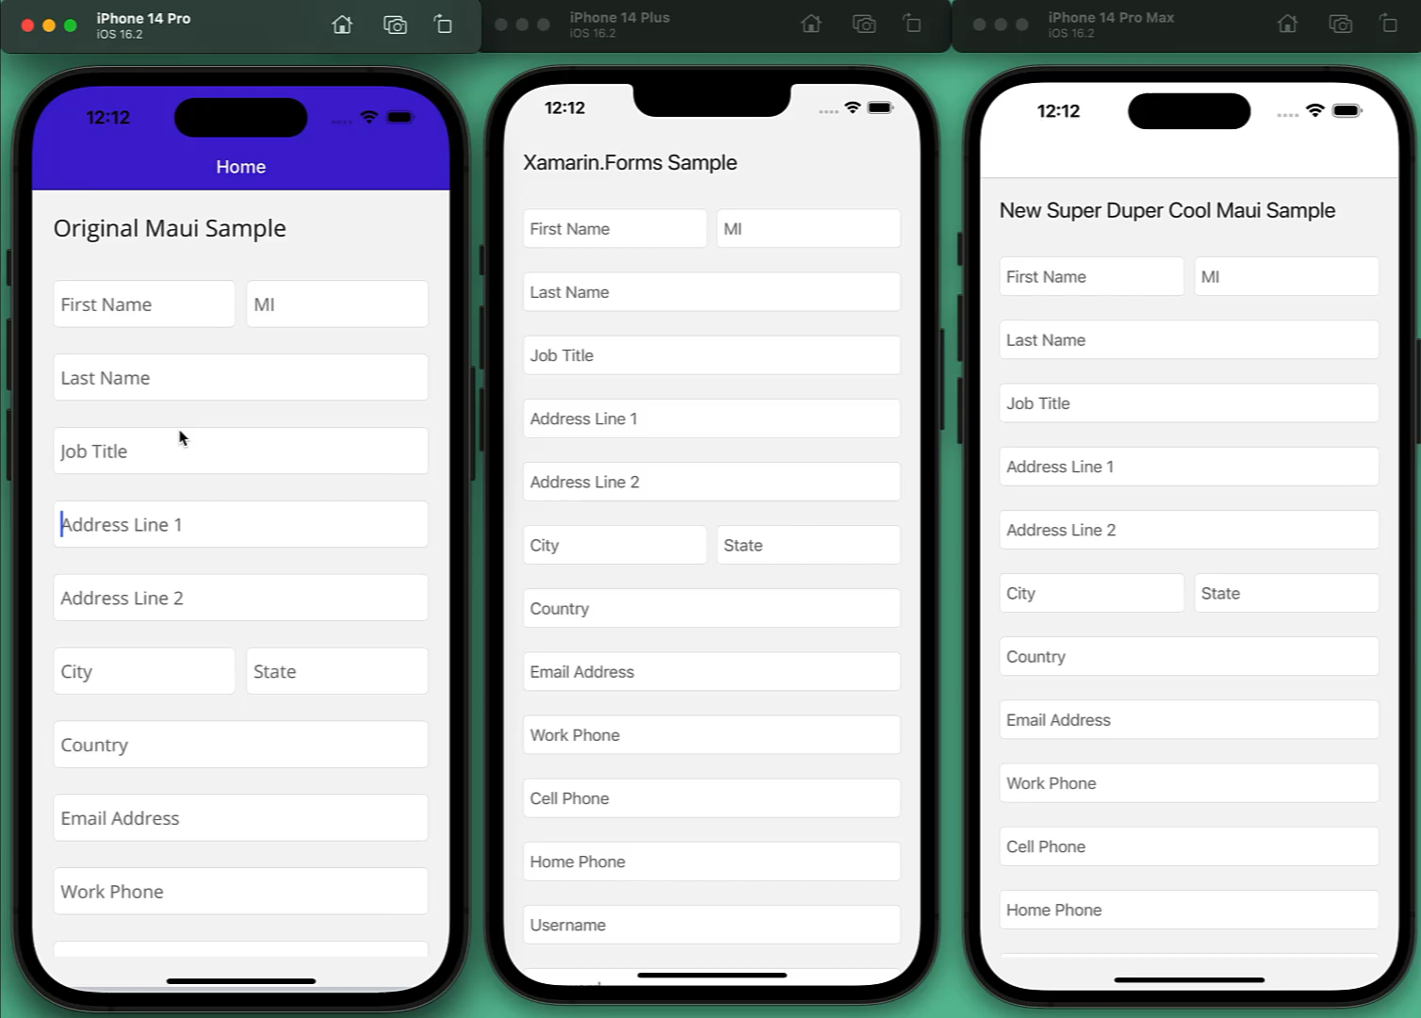
Keyboard Improvements
No keyboard overlap
Scroll to focus
Tabbing/Next defaults

Slide 24

Productivity with GitHub Copilot

Slide 25
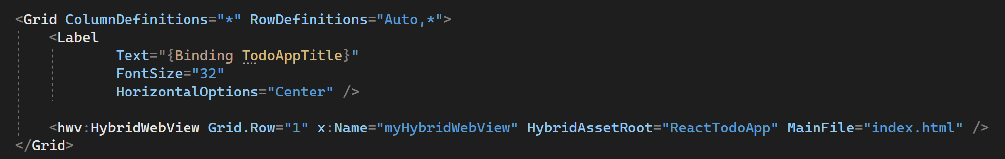
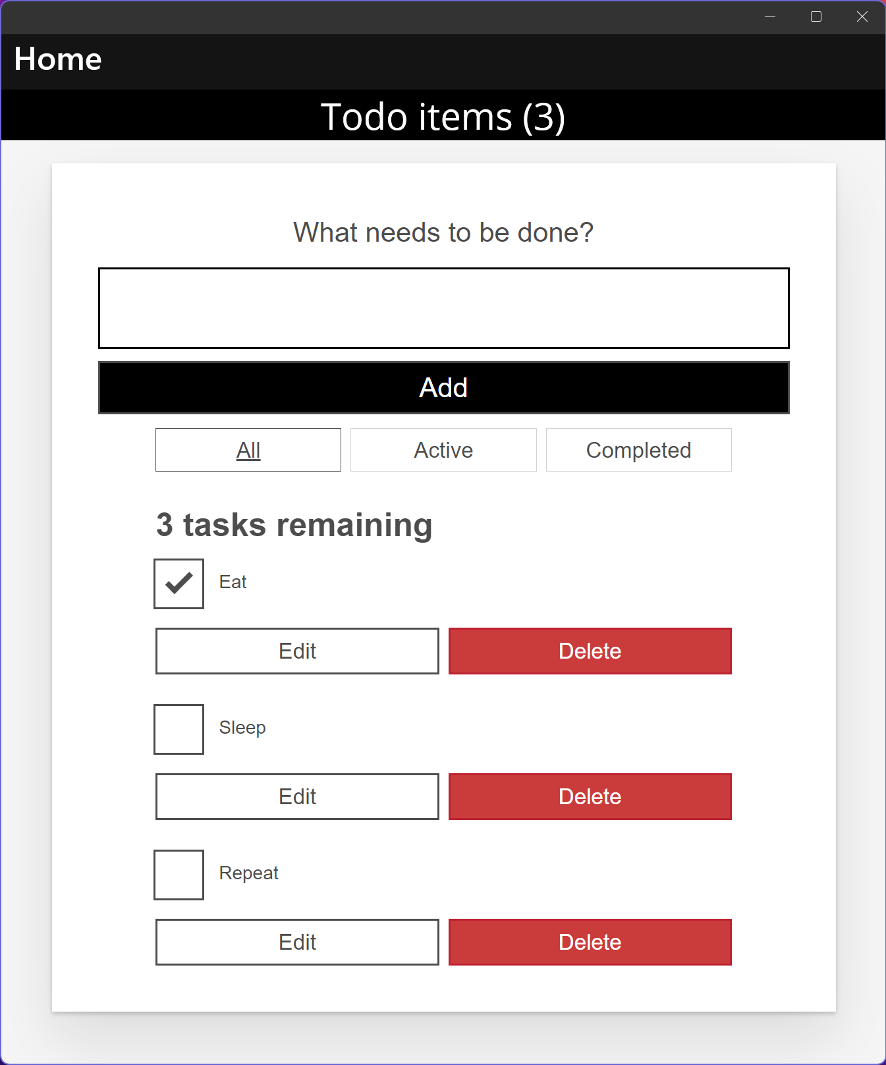
Experimental
https://aka.ms/MauiHybridWebView
HybridWebView for Angular, ReactJS, Vue, etc.
MAUI C#
Native app container and controls
Multi-platform control based on .NET MAUI WebView
Host static web assets (HTML, JS, CSS, etc.)
Communicate between JavaScript and .NET
Reuse your Angular, React, etc. investments in MAUI native desktop and mobile apps
Use any web-based UI and it can interact with C# code
Looking for feedback!
Hybrid WebView React JS

Slide 26
Release schedule, support & patching
Patches for 18 months (6 months after .NET 8 ships)
.NET MAUI
.NET 7
Nov 2022
.NET 8
Nov 2023
.NET 9
Nov 2024
14
Xcode
32, 33
Android
Xamarin
EOS May 2024
A major version of .NET MAUI will ship with .NET going forward (.NET 7, .NET 8, etc.)
.NET MAUI is an optional workload with external dependencies (such as Xcode & Android SDK tools)
A major version of .NET MAUI will receive patches for 6 months after a successor (major version) ships
Xamarin SDKs will receive support until May 2024

Slide 27
Start Using .NET MAUI
dot.net/maui

Slide 28
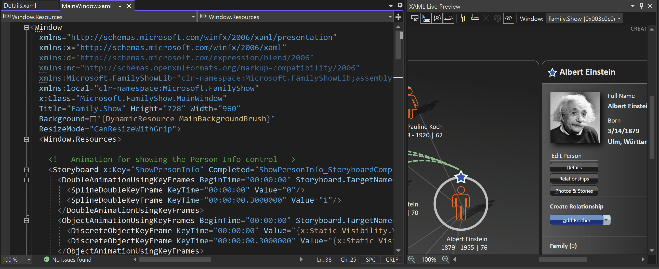
Rapid Development with Visual Studio 2022
visualstudio.microsoft.com
Rapid UI Iteration
XAML and C# Hot Reloading
Live App Preview with UI Tree Inspection
Remote iOS development with Pair to Mac
Local iOS development with Hot Restart

Slide 29
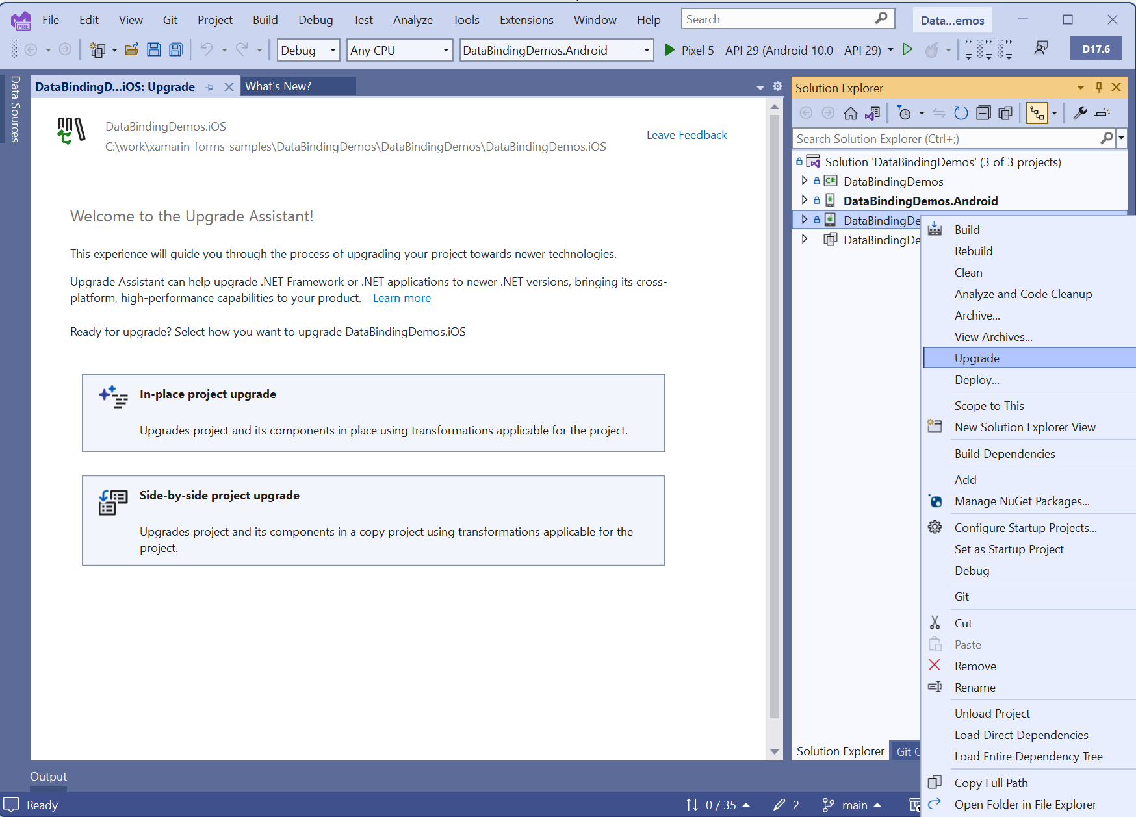
.NET Upgrade Assistant for Xamarin Projects
Highlights:
Converts projects
Replaces known NuGets
Fixes namespaces
Fixes base types
Applies various code updates
maui-upgrades@microsoft.com

Slide 30









Follow .NET – dot.net
aka.ms/dotnet/blog
aka.ms/dotnet/twitter
aka.ms/dotnet/mastodon
aka.ms/dotnet/youtube
aka.ms/dotnet/forums
aka.ms/dotnet/tiktok
aka.ms/dotnet/linkedin
aka.ms/dotnet/facebook
aka.ms/dotnet/github
aka.ms/dotnet-discord

Slide 31
Microsoft Logo
Thank You!
Matthew Leibowitz | Software Guy at MS | @mattleibow

